Slide 1
4NF and 5 NF

Slide 2
Fourth Normal Form
For a table to satisfy the Fourth Normal Form, it should satisfy the following two conditions:
It should be in the Boyce-Codd Normal Form (BCNF).
And, the table should not have any Multi-valued Dependency.

Slide 3
Multivalued dependency
For a dependency A → B, if for a single value of A, multiple value of B exists, then the table may have multi-valued dependency.
Also, a table should have at-least 3 columns for it to have a multi-valued dependency.
And, for a relation R(A,B,C), if there is a multi-valued dependency between, A and B, then B and C should be independent of each other.
If all these conditions are true for any relation(table), it is said to have multi-valued dependency.
A multivalued dependency is a special case of a join dependency, with only two sets of values involved, i.e. it is a binary join dependency.

Slide 4
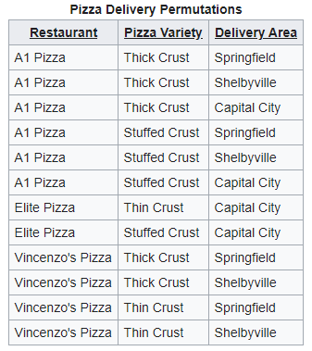
4NF Example
{Restaurant}
Each row indicates that a given restaurant can deliver a given variety of pizza to a given area.
The table has no non-key attributes because its only key is {Restaurant, Pizza Variety, Delivery Area}. Therefore, it meets all normal forms up to BCNF.
Pizza varieties offered by a restaurant are not affected by delivery area.
Two multivalued dependencies on the {Restaurant} attribute:
{Restaurant} -->> {Pizza Variety}
{Restaurant} -->> {Delivery Area}

Slide 5
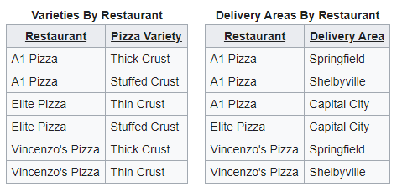
4NF Example

Slide 6
5NF
A relation is in 5NF if it is in 4NF and not contains any join dependency and joining should be lossless.
5NF is satisfied when all the tables are broken into as many tables as possible in order to avoid redundancy.
5NF is also known as Project-join normal form (PJ/NF).

Slide 7
JOIN DEPENDENCY
If a table can be recreated by joining multiple tables and each of this table have a subset of the attributes of the table, then the table is in Join Dependency.
It is a generalization of Multivalued Dependency.
Join Dependency can be related to 5NF, wherein a relation is in 5NF, only if it is already in 4NF and it cannot be decomposed further.

Slide 8
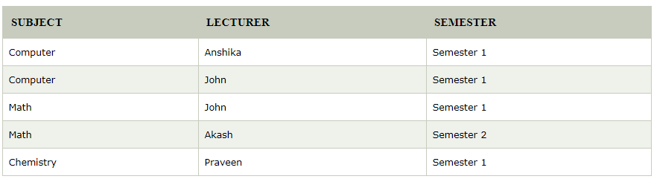
5NF Example
John takes both Computer and Math class for Semester 1 but he doesn't take Math class for Semester 2. This implies that combination of all these fields required to identify a valid data.
Suppose we add a new Semester as Semester 3 but do not know about the subject and who will be taking that subject so we leave Lecturer and Subject as NULL.
But all three columns together acts as a primary key, so we can't leave other two columns blank.
To make the above table into 5NF, we can decompose it into three relations

Slide 9
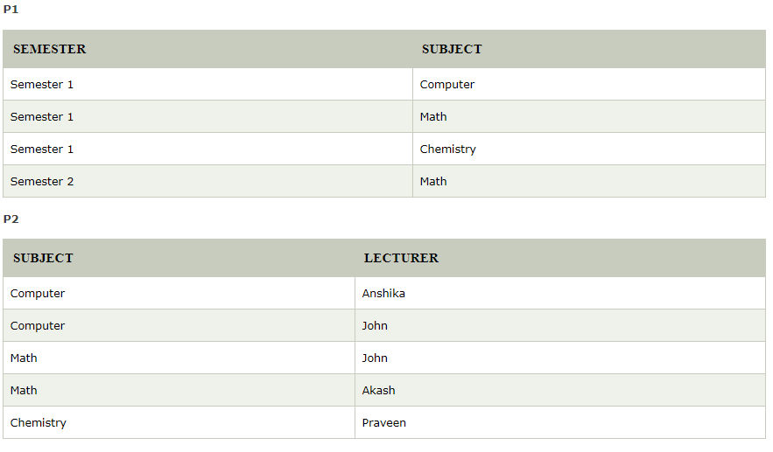


Slide 10
THANK YOU

